Slide 2
Agile Extention Training
Date. Boughdiri Aymen

Slide 3
ISTQB
Fondé officiellement in Edenburg en Novembre 2002
Organisme à but non lucratif qui fournit les bonnes pratiques de tests logiciels
Développé par plus de 100 experts dans plus que 40 pays
ISTQB est la certification la plus reconnue dans le monde de test logiciel
Il y a plus que 450000 testeurs certifiés à travers le monde

Slide 4
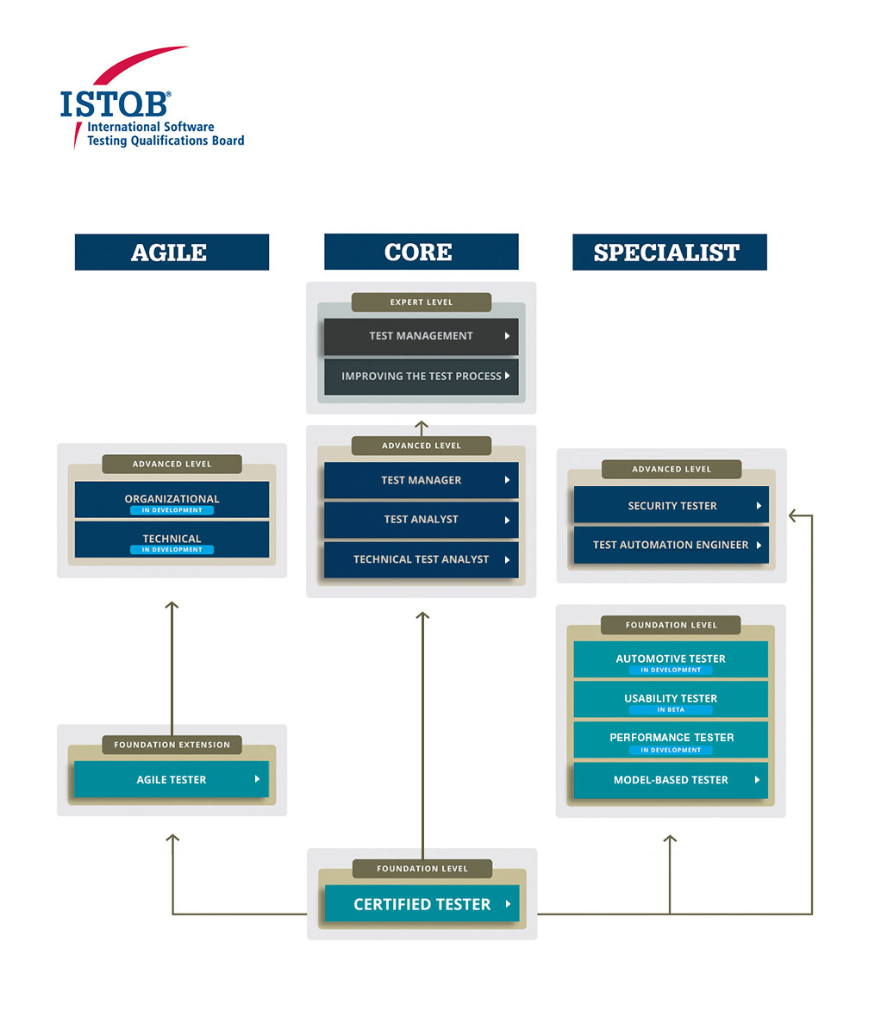
ISTQB

Slide 5
ISTQB
5
40 Multiple choice questions
Each good answer gives one point
To succeed, the participant needs to have at least 65% of good answers (26 good answers)
The exam lasts 60 minutes

Slide 6
Table of Contents
Chapter 1 : Agile Software Developement
Chapter 2 : Fundamental Agile Testing Principles, practices, and processes
Chapter 3 : Agile testing Methods, Techniques, and Tools
Test

Slide 7
Chapter 1 : Agile Software Developement

Slide 8
Chapter 1 : Agile Software Developement
The Fundamentals of Agile Software Development
Aspects of Agile Approaches

Slide 9
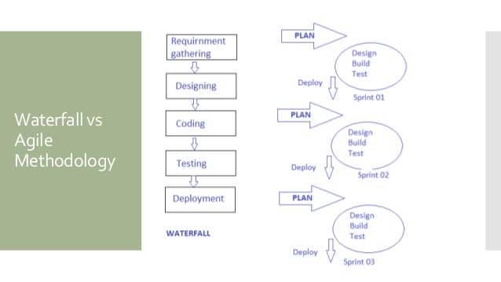
1.1 The Fundamentals of Agile Software Development

Slide 10
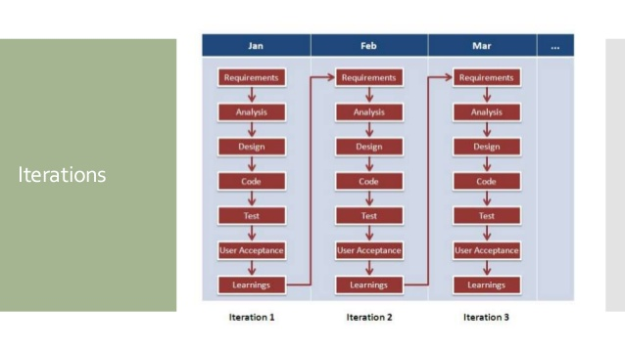
1.1 The Fundamentals of Agile Software Development

Slide 11
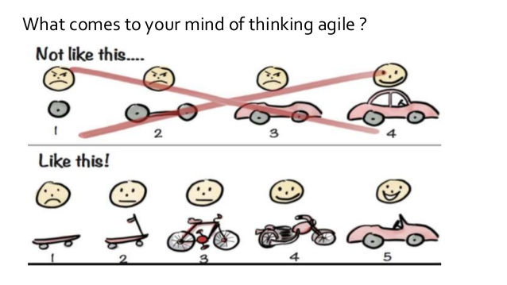
1.1 The Fundamentals of Agile Software Development

Slide 12
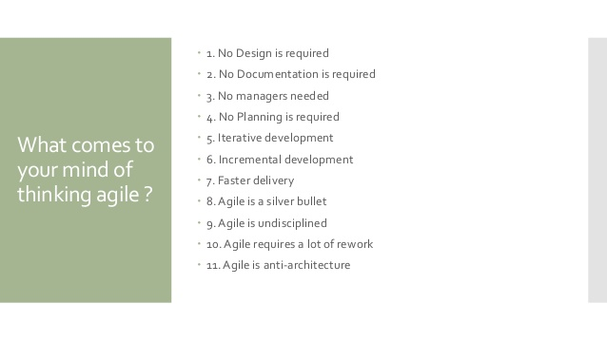
1.1 The Fundamentals of Agile Software Development

Slide 13
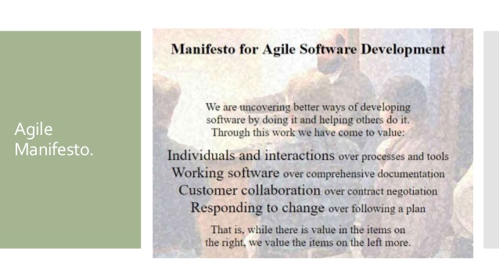
1.1 The Fundamentals of Agile Software Development
13

Slide 14
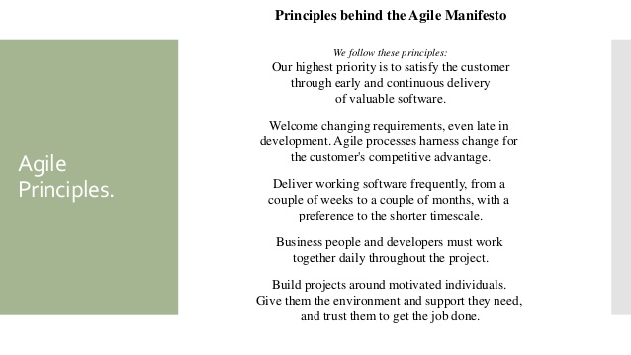
1.1 The Fundamentals of Agile Software Development

Slide 15
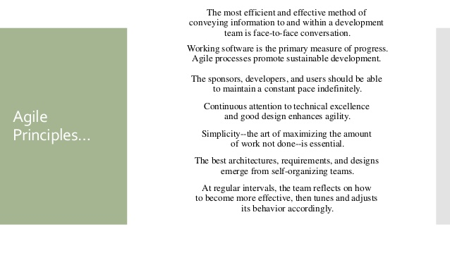
1.1 The Fundamentals of Agile Software Development
15

Slide 16
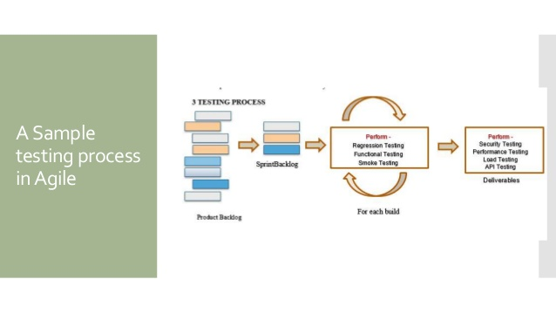
1.1 The Fundamentals of Agile Software Development

Slide 17
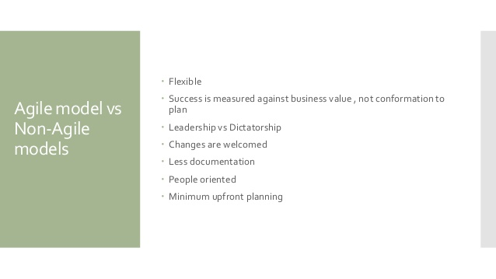
1.1 The Fundamentals of Agile Software Development

Slide 18
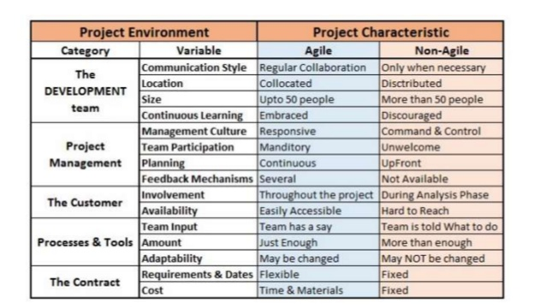
1.1 The Fundamentals of Agile Software Development

Slide 19
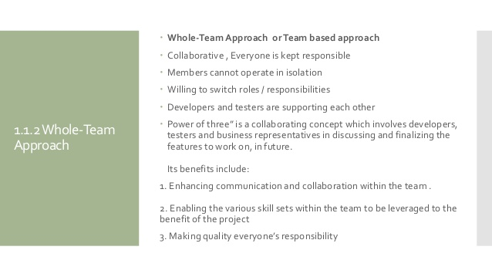
1.1 The Fundamentals of Agile Software Development

Slide 20
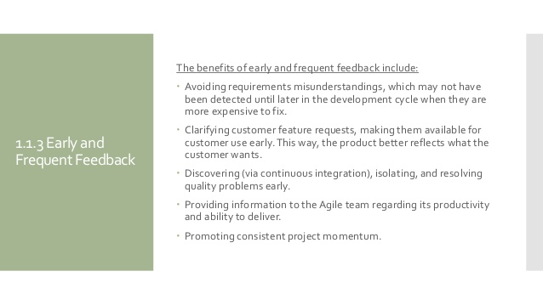
1.1 The Fundamentals of Agile Software Development
Notes:
C’est la question à un million de dollars

